Slide 1
Writing Instructions & Manuals

Slide 2
1
Writing Instructions
2
Designing a Set of Instructions
目 录
CONTENTS
3
Planning for Safety
4
Drafting Effective Instructions
5
Writing Manuals
Notes:
curriculum vitae英[kəˌrɪkjələm ˈvi:taɪ]

Slide 3
Defining Instructions
Instructions are process descriptions written to help readers perform a specific task.
explain how to do something
explain how something happens
Readers of a process description want to understand the process.
Readers of instructions want a step-by-step guide to help them perform the process.
Effective instructions are based on writing good descriptions.

Slide 4
Guidelines
To design pages that are clear and attractive, follow these two guidelines:
Create an open, airy design
Don’t squeeze too much information onto the page.
Build in space for wide margins and effective line spacing, use large type, and chunk the information effectively.
Clearly relate the graphics to the text
Present graphics to accompany every step or almost every step.
Create a design that makes it clear which graphics go with each text passage.

Slide 5
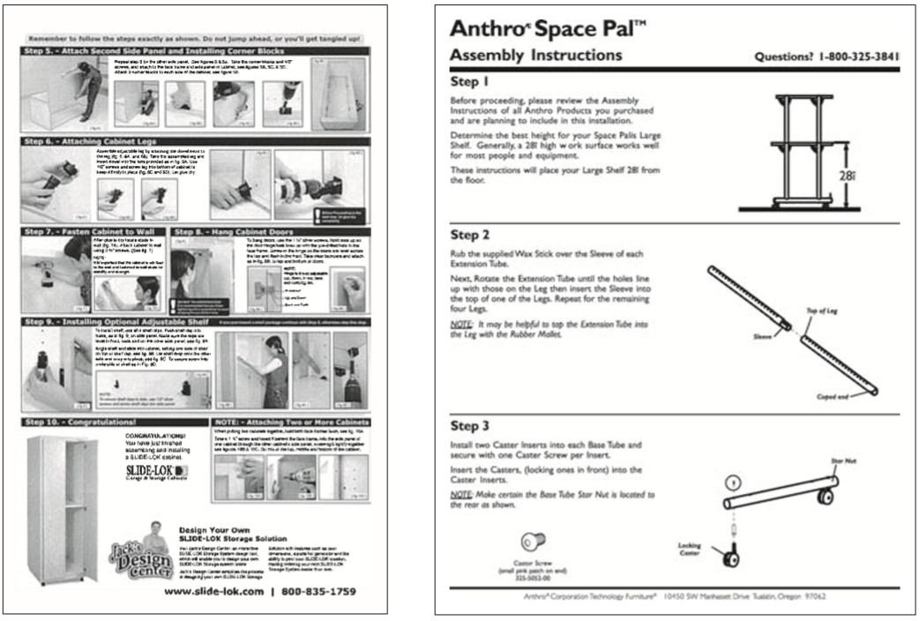
Which one do you think is clear and attractive?

Slide 6
Planning for Safety
When the subject you are writing about involves safety risks, the most important responsibility for you is to do whatever you can to ensure your readers’ safety.
The best way to keep your readers safe is to be honest and write clearly.
If the readers will encounter safety risks, explain what those risks are and how to minimize them.
Protecting your readers’ safety is
a question of rights
Readers are entitled to the best information.
a question of law
People who get hurt can sue the company that made the product or provided the service.

Slide 7
When writing a message on safety, be clear and concise, avoiding complicated sentences.
It is required that safety glasses be worn when inside this laboratory.
You must wear safety glasses in this laboratory.
Wear safety glasses in this laboratory.
complicated
simple
Sometimes a phrase works better than a sentence.
Safety Glasses Required.

Slide 8
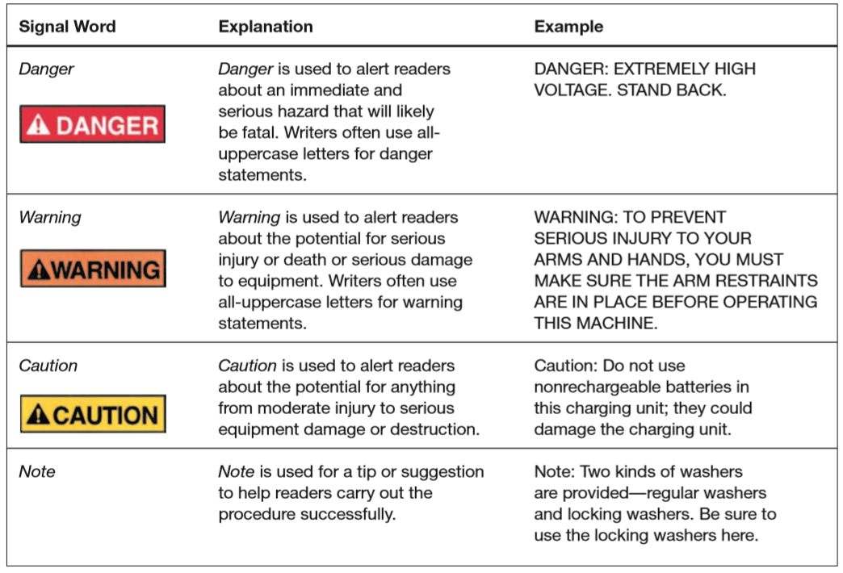

Four most important signal words
words accompanied by symbols showing the color combinations endorsed by ANSI
American National Standards Institute
Notes:
1918年，美国材料试验协会（ASTM）、与美国机械工程师协会（ASME）、美国矿业与冶金工程师协会（ASMME）、美国土木工程师协会（ASCE）、美国电气工程师协会（AIEE）等组织，共同成立了美国工程标准委员会（AESC）。美国政府的三个部（商务部、陆军部、海军部）也参与了该委员会的筹备工作。 1928年，AESC改组为美国标准协会（ASA）。1966年8月，又改组为美利坚合众国标准学会（USASI）。1969年10月6日改成现名：美国国家标准学会（ANSI）。

Slide 9

A typical safety label that incorporates both ANSI and ISO standards
consistent with the ISO approach
icons
consistent with the ANSI approach
words
Whether the safety information is printed in a document or on machinery or equipment, it should be prominent and easy to read.
Notes:
ISO=International Organization of Standardization

Slide 10
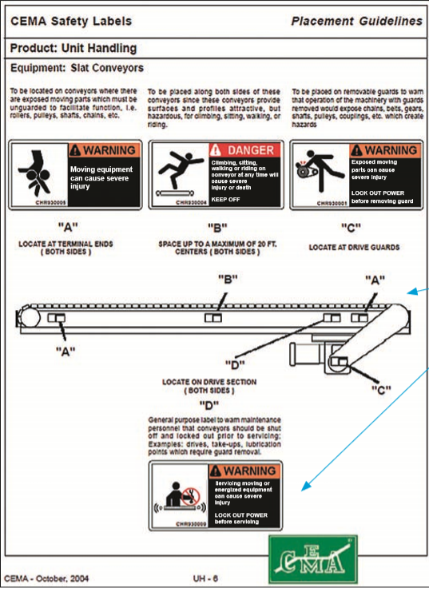
Where should the safety information be placed on machinery or equipment?
No easy answer because you cannot control how your audience reads your document.
Put safety information wherever you think the reader is likely to see it.
Don’t be afraid to repeat it, e.g. a reasonable amount of repetition is effective.

Slide 11
Drafting Effective Instructions
Instructions can be brief (a small sheet of paper) or extensive (up to 20 pages or more).
Most instructions are organized in terms of a process.
The main difference: the conclusion of a set of instructions is not a summary but an explanation of how to make sure readers have followed the instructions correctly.
Most sets of instructions contain the following four elements:
(1) a title
(3) step-by-step instruction
(2) a general introduction
(4) a conclusion

Slide 12
Title
simple and clear
Two common forms of starting a sentence:
How-to: “How to install the J112 Shock Absorber”
Gerund: “Installing the J112 Shock Absorber”
Avoid the noun string: “J112 Shock Absorber Installation Instructions”, which is awkward and difficult for readers to understand

Slide 13
General Introductions
The general introduction provides the preliminary information readers need to know.
Who carries out this task?
Why does the reader carry out this task?
When does the reader carry out this task?
What safety measures or other concerns should the reader understand?
What items does the reader need?
List necessary tools, materials, and equipment needed
How long will the task take?
Consider the time it takes for individuals with different experience---no experience, some experience, or much experience.

Slide 14
Step-by-Step Instructions
Number the instructions.
Provide the right amount of information in each step.
Use the imperative mood.祈使句
More direct and economical.
Avoid the passive voice.
Do not confuse steps and feedback statements.
A step is an action that the reader is to perform.
A feedback statement describes an event that occurs in response to a step.
Include graphics.
Do not omit articles (a, an, the) to save space.
Omitting articles can make the instructions unclear and hard to read.
“Locate midpoint and draw line”

Slide 15
Too much information
1. Mix one part cement with one part water, using the trowel. When the mixture is a thick consistency without any lumps bigger than a marble, place a strip of the mixture about 1’’ high and 1’’ wide along the face of the brick. Too
1. Pick up the trowel.
1. Mix one part cement with one part water, using the trowel泥铲, until the mixture is a thick consistency without any lumps bigger than a marble.
2. Place a strip of the mixture about 1’’ high and 1’’ wide along the face of the brick.
Too little information
Too much information

Slide 16
Conclusions
An Instruction often concludes
by stating that the reader has now completed the task
by describing what the reader should do next.
Now that you have replaced the glass and applied the glazing compound玻璃密封胶, let it sit for at least five days so that the glazing can cure. Then, prime填装 and paint the window.
Some conclusions end with maintenance tips or a troubleshooting检修 guide.
A troubleshooting guide, usu. presented as a table, identifies common problems and explains how to fix them.

Slide 17
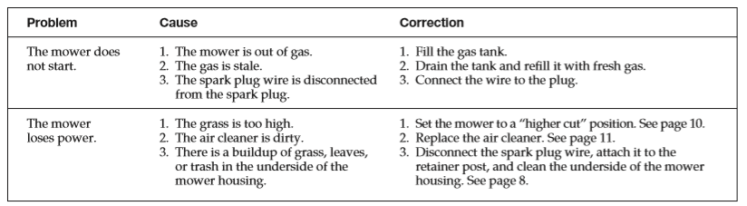
Excerpt from a Troubleshooting Guide

Slide 18
Writing Manuals
There is no absolute distinction between a set of instructions and a manual.
The two share a main purpose: to explain how to carry out a task safely, effectively, and efficiently.
A set of instructions is typically shorter and more limited in its subject.
Manuals tend to be longer and more involved than instructions.
Both kinds of documents can conclude safety information.
A manual includes much of the same sort of information found in a set of instructions.
The main difference between the two is that a manual has more elaborate front matter扉页 and back matter末尾的书页.

Slide 19
Front matter
The introduction, sometimes called a preface, often contains an overview of the contents, frequently in the form of a table, which explains the main contents of each section and chapter.
It also contains a conventions section, which explains the typography排版 of the manual.
It also might include a where to get help section, referring readers to other sources of information, such as the company’s Website and customer-support center.
It might contain a section listing the trademarks of the company’s own products and those of other companies.

Slide 20
Back matter
Manuals typically include
a set of specifications of the device or system,
a list of relevant government safety regulations and industry standards that the device or system supports,
tips on maintenance and servicing the device,
a copyright page listing bibliographic information about the manual,
an index.
Many manuals also include glossaries.

Slide 21
Organizations work hard to make their instructions and manuals appropriate for multicultural readers.
You need to answer three important questions as you plan the documents：
In what language should the information be written?
You can either translate the document into the reader’s native language or use Simplified English with a limited grammar and vocabulary to make it easy to understand.
Do the text or graphics need to be modified?
You need to be aware of cultural differences.
Left hand in the US vs. left hand in the Middle East
What is the readers’ technological infrastructure?
If your readers don’t have Internet access, there is no point in making a Web version of the information.

Slide 22
Questions for review
Are the instructions designed effectively, with adequate blank space and a clear relationship between the graphics and the accompanying text?
Do the instructions have a clear title?
Does the introduction to the set of instructions
state the purpose of the task?
describe safety measures or other concerns that readers should understand?
list necessary tools and materials?
Are the step-by-step instructions
numbered?
expressed in the imperative mood?
simple and direct?
Are appropriate graphics included?
Does the conclusion
include any necessary follow-up advice?
include, if appropriate, a troubleshooting guide?

Slide 23
Thanks for your attention!

